Slide 1

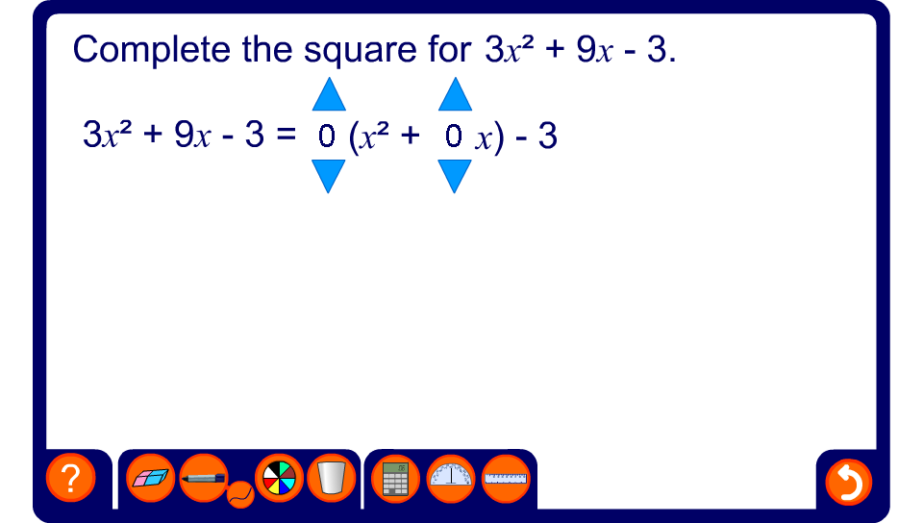


Expressions in the form ax² + bx + c

